Slide 1
Shellsort & Comb Sort

Slide 2
Shell sort
Insertion sort is very effective in some cases.
Problem is that it exchanges with each item until less one is found, so it each step is very small.
In shell sort, we try with bigger steps.

Slide 3
Idea is to sort every h element instead of each single one.
Then decrease h (also called gap, spacing etc) until it becomes 1.
i.e. h-sort for decreasing values of h
When h is 1, it means we will be running insertion sort on the items.
Advantage is, since most of the items should be sorted by this time, we will not require a lot of exchanges.

Slide 4
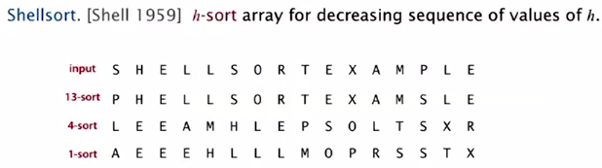

Slide 5
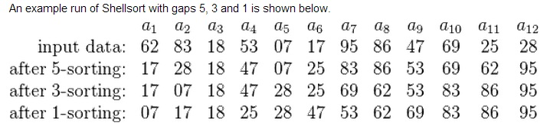
-wikipedia.com

Slide 6
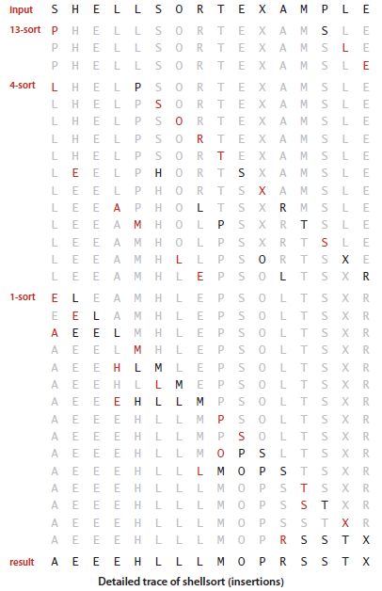

Slide 7
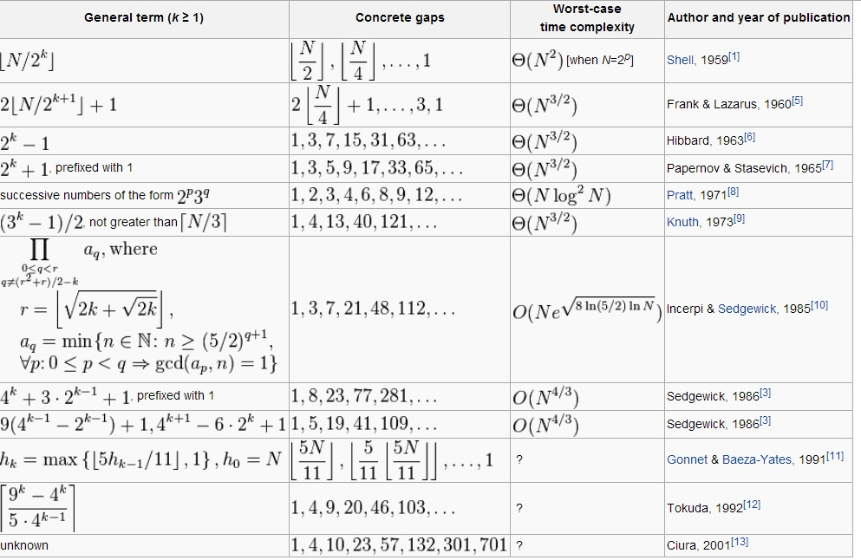

Slide 8
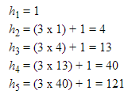
Knuth’s 3x + 1
Sedgewick: 1, 5, 19, 41, 109, 209 …
For example, start with h=19?

Slide 9
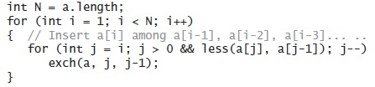
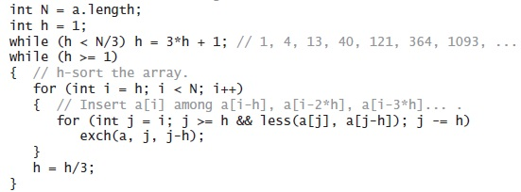
INSERTION SORT
SHELL SORT

Slide 10
O(?)
Depends on the gap sequence.
For 3h+1, it is O(n^(3/2))

Slide 11
Comb Sort
Comb Sort is mainly an improvement over Bubble Sort. Bubble sort always compares adjacent values. So all inversions are removed one by one. Comb Sort improves on Bubble Sort by using gap of size more than 1. The gap starts with a large value and shrinks by a factor of 1.3 in every iteration until it reaches the value 1. Thus Comb Sort removes more than one inversion counts with one swap and performs better than Bubble Sort.
The shrink factor has been empirically found to be 1.3 (by testing Combsort on over 200, 000 random lists) [Source: Wiki]
Although, it works better than Bubble Sort on average, worst case remains O(n2).
[Source: https://www.geeksforgeeks.org/]

Slide 12
Experimental runs indicate that the improvement is indeed dramatic and the impressive performance of comb sort is comparable to the performance of quicksort

Slide 13
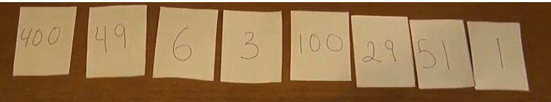

Slide 14
public class CombSort {
// To find gap between elements
int getNextGap(int gap)
{
// Shrink gap by Shrink factor
gap = (gap) / 1.3;
if (gap < 1)
return 1;
return gap;
}

Slide 15
// initialize gap
int gap = n;
boolean swapped = true;
while (gap != 1 || swapped == true) {
// Find next gap
gap = getNextGap(gap);
swapped = false;
// Compare all elements with current gap
for (int i = 0; i < n - gap; i++) {
if (arr[i] > arr[i + gap]) {
// Swap
int temp = arr[i];
arr[i] = arr[i + gap];
arr[i + gap] = temp;
swapped = true;

